Slide 1
Evaluation with a Racial Equity Lens
Sally Leiderman, CAPD
November 2017
sleiderman@capd.org
Please cite this presentation as: Leiderman, Sally. “Evaluation with a Racial Equity Lens Slides.” November 2017. www.capd.org

Slide 2
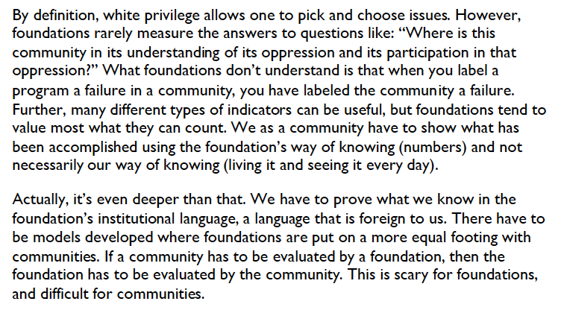
From “Flipping the Script: White Privilege and Community Building” https://static1.squarespace.com/static/536ce727e4b0a03c478b38e4/t/560193c3e4b0f36f1e77df53/1442943939596/Flipping+the+Script.pdf

Slide 3
Every evaluation is political and technical
What constitutes success, and who says so?
What resources are committed to ensuring that we will have sufficient and accurate data to disaggregate by race/ethnicity?
What early or mid-point changes are likely to predict longer-term success, given likely resistance and retrenchment?
What protections are in place for those with less power in the process?

Slide 4
Every evaluation is political and technical
What types of qualitative and quantitative data are considered reliable and valid, and by whom?
Who “owns” data? Who sees data first and what are the processes for addressing different perspectives on findings and conclusions, if there are any?
How are findings presented and shared in ways that do not “blame the victim”?
What are the likely consequences of positive or negative findings? Whose responsibility, if it is anyone’s to address differential consequences based on power dyamics?

Slide 5
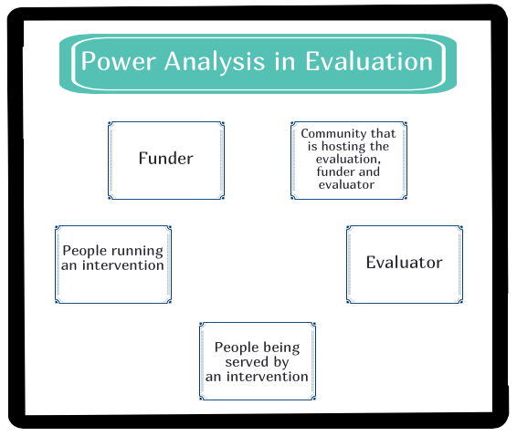

Slide 6
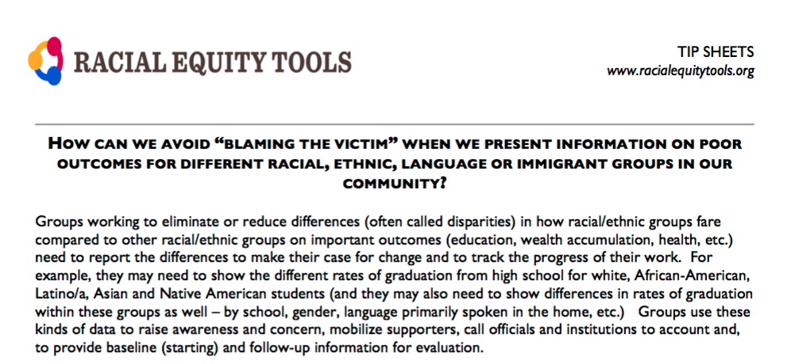
Source: http://www.racialequitytools.org/resourcefiles/How_Can_We_Avoid_“Blaming_The_Victim”_When_We_Present_Information_On_Poor_Outcomes_For_Different_Racial__Ethnic__Language_Or_Immigrant_Groups_In_Our_Community.pdf

Slide 7
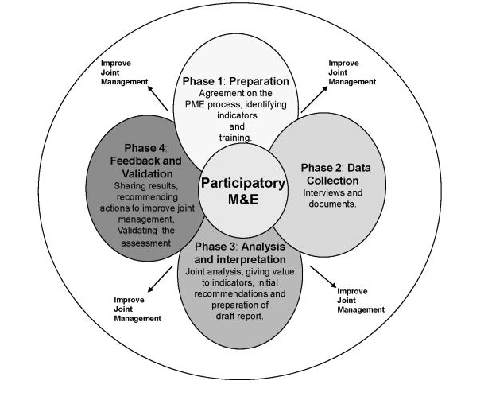
What does a typical participatory evaluation look like in practice?
Source: https://participationdictionary.files.wordpress.com/2014/04/figure2.jpg

Slide 8
Embedding a structural racism lens in evaluation - some ideas
Collect sufficient data to disaggregate by each racial/ethnic group of interest to the issue (e.g. urban Native Americans and Native Americans on the reservation)
Collect sufficient data to disaggregate by areas of intersectionality
Acknowledge the limitations and controversies of Census definitions - where possible, ask people open-ended questions about identity. For example, “How do you define yourself in terms of…”
Check the algorithms of any “summarized data” or administrative data that has consequences (e.g. reported incidences of interpersonal violence) and lay out clearly the limitations of the data
Frame findings in terms of systemic issues; i.e., if you report differential rates of high school graduation by race/ethnicity or language spoken in the home, also show availability of AP classes in the school

Slide 9
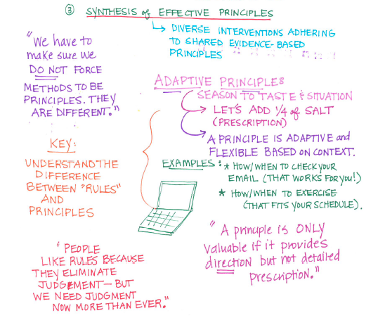
Source: https://www.slideshare.net/KatherineHaugh/mqp-eval14-notes

Slide 10
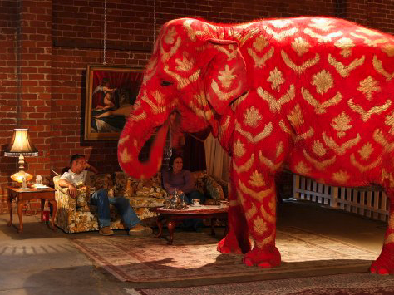
Some things we are thinking about in our practice right now
Redefining rigor
Redefining risk
Redistributing consequences

Slide 11
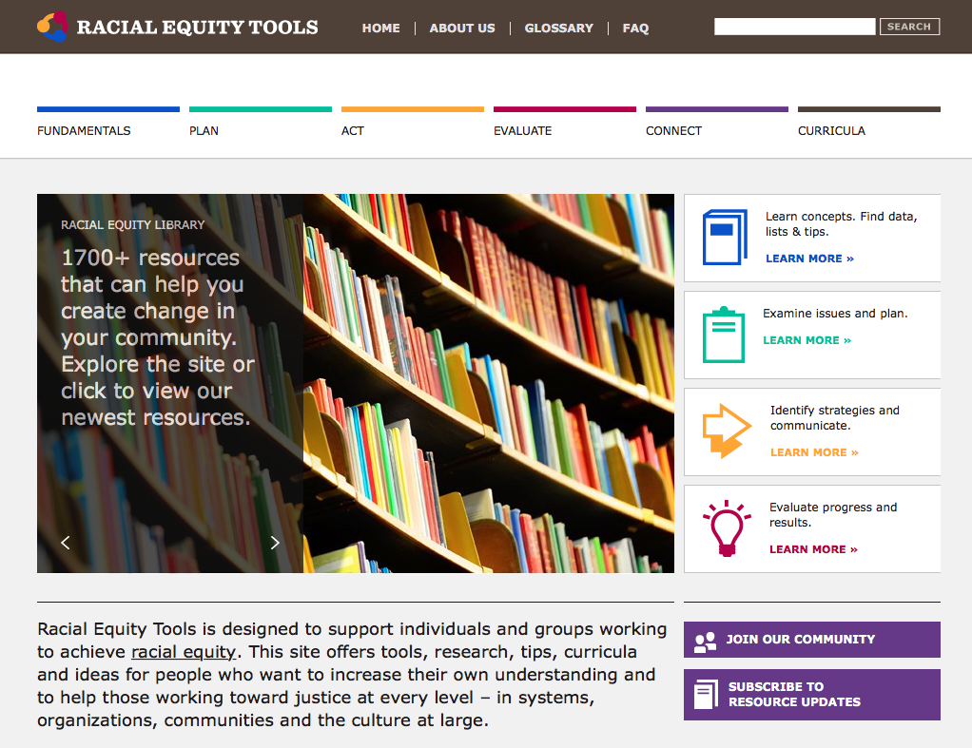

Slide 12
Additional Resources
Center for Culturally Responsive Evaluation and Assessment https://crea.education.illinois.edu
Racial Equity Tools www.racialequitytools.org
Transforming White Privilege Curriculum https://www.racialequitytools.org/module/overview/transforming-white-privilege
Equitable Evaluation https://www.equitableeval.org/
NCRP Philamplify indicators http://www.philamplify.org/about-philamplify/philamplify-assessment-criteria/

Slide 13
“White privilege and time are elements that get in the way of relationships and progress. How foundations and how communities value time may be worlds apart. In the foundation, time is something you save; in the community, time is something you spend.”
From “Flipping the Script: White Privilege and Community Building” https://static1.squarespace.com/static/536ce727e4b0a03c478b38e4/t/560193c3e4b0f36f1e77df53/1442943939596/Flipping+the+Script.pdf

